Slide 1
Lab3
Pthread & OpenMP
17 Oct 2019 Parallel Programming

Slide 2
Lab3 Tasks
Practice 1: Approximate π using pthread
Practice 2: OpenMP
Practice 3: Approximate π using MPI & OpenMP ---
Deadline of the 3 practices is 10/24 23:59
Check and hand in your codes with lab3-check if you do not pass any of the practices in lab
If you do not come to lab3, you DO NOT have to DEMO your code to TAs. TA will check your code after deadline.

Slide 3
SLURM quick reference
srun [flags] ./prog ============ or ============ #!/bin/bash #SBATCH [flags] srun ./prog # (MPI) ./prog # (non-MPI) --------- run with: -------- sbatch job.sh
[flags]: -N number of nodes -n number of processes -c CPUs per process -t additional time limit -J name of job

Slide 4
Outline
Pthread
Hello world
Mutex
OpenMP
OpenMP + MPI

Slide 5
Running pthread programs on apollo
SYNOPSIS #include <pthread.h> int pthread_create( pthread_t *thread, const pthread_attr_t *attr, void *(*start_routine) (void *), void *arg); Compile and link with -pthread.
Type `man pthread_create` in terminal to see this

Slide 6
Running pthread programs on apollo
cp /home/pp19/share/lab3/hello_pthread.c .
compile gcc hello_pthread.c -o hello_pthread -pthread
execute srun -c4 -n1 ./hello_pthread 4 -c4 means 4 CPUs per process -n1 means 1 process You can use sbatch as well
NOT -lpthread

Slide 7
Outline
Pthread
Hello world
Mutex
OpenMP
OpenMP + MPI

Slide 8
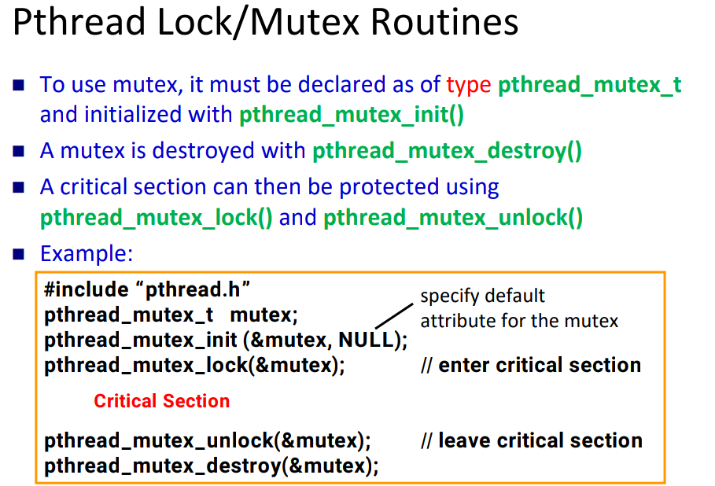

Slide 9
Mutex
man pthread_mutex_init
#include <pthread.h> pthread_mutex_t mutex = PTHREAD_MUTEX_INITIALIZER;
int pthread_mutex_lock(pthread_mutex_t *mutex); int pthread_mutex_trylock(pthread_mutex_t *mutex); int pthread_mutex_unlock(pthread_mutex_t *mutex);
man pthread_mutex_lock

Slide 10
Mutex:
[Practice 1] approximate π using pthread
gcc pi_pthread.c -o pi_pthread -pthread -lm
srun -c4 -n1 ./pi_pthread 4 500000000
Sequential pi at /home/pp19/share/lab3/pi.c
code filename
executable filename
we’re using pthread
number of points
number of threads
number of threads

Slide 11
Outline
Pthread
Hello world
Mutex
OpenMP
OpenMP + MPI

Slide 12
Running OpenMP programs on apollo:
example (/home/pp19/share/lab3)
compile gcc hello_omp.c -o hello_omp -fopenmp
execute srun -c4 -n1 ./hello_omp -c4 means 4 CPUs per process -n1 means 1 process You can use sbatch as well Try different number of threads!
OpenMP automatically detects number of CPUs from SLURM (affinity)
So we don’t have to specify it again

Slide 13
Count prime numbers:
sequential version
gcc -lm prime.c -o prime srun ./prime 1000 srun ./prime 10000000

Slide 14
Count prime numbers:
[Practice 2] OpenMP
1. Modify the sequential prime.c with openmp
2. Try to see the effect of changing dynamic/static scheduling chunk size number of threads
[example commands] gcc -lm omp_prime.c -o omp_prime -fopenmp srun -c4 -n1 ./omp_prime 10000000

Slide 15
Outline
Pthread
Hello world
Mutex
OpenMP
OpenMP + MPI

Slide 16
Hybrid MPI and OpenMP program
mpicc hello_hybrid.c -o hello_hybrid -fopenmp
srun -c3 -n2 ./hello_hybrid
We’re using MPI
We’re using OpenMP
3 threads
2 processes

Slide 17
Hybrid MPI and OpenMP program:
Hello World
srun -c3 -n2 -N2 ./hello_hybrid Hello apollo32: rank 0/ 2, thread 0/ 3 Hello apollo32: rank 0/ 2, thread 1/ 3 Hello apollo32: rank 0/ 2, thread 2/ 3 Hello apollo33: rank 1/ 2, thread 0/ 3 Hello apollo33: rank 1/ 2, thread 1/ 3 Hello apollo33: rank 1/ 2, thread 1/ 3

Slide 18
Hybrid MPI and OpenMP program:
[Practice 3] Approximate π
Use MPI and OpenMP to approximate π
(You can refer to your code in lab1)
mpicc hybrid_pi.c -o hybrid_pi -fopenmp -lm srun -N2 -n6 -c4 ./hybrid_pi 100000000

